Slide 1
INTRODUCTION TO ALGORITHMS

Slide 2
ALGORITHM
An algorithm is a procedure or step-by-step instruction for solving a problem.
They form the foundation of writing a program

Slide 3
ALGORITHM FOR FINDING ROOTS OF A QUADRATIC EQUATION
Step 1- START
Step2- declare variables a,b,c,D,r1,r2,rp &ip;
Step3- calculate discriminate D=b*b-4*a*c;
Step 4- if D greater than or equal to zero then goto step 5 else goto step 6
Step 5- r1=(-b+sqrt(D))/2*a;
r2=(-b-sqrt(D))/2*a;
Display r1 and r2 are roots
Step 6- else if D==0 false goto step 7
Display roots are equal;
Step 7- else Calculate real part and imaginary part
rp=b/2*a;
ip=sqrt(-D)/2*a;
Display rp+j(ip)
rp-j(ip)
Step 8- STOP

Slide 4
ALGORITHM FOR FINDING MAXIMUM AND MINIMUM OF THE GIVEN SET OF NUMBERS
Step 1:start
step 2:input a, b, c
step 3:if a>b go to step 4,otherwise go to step 5
step 4:if a>c go to step 6,otherwise go to step 8
step 5:if b>c go to step 7,otherwise go to step 8
step 6:Print "a is the largest ",go to step 9
Step 7 : Print "b is the largest", goto step 9
Step 8 : Print " c is the largest", goto step 9
Step 9 : Stop

Slide 5
WRITE AN ALGORITHM TO FIND IF THE NUMBER IS PRIME

Slide 6
SEARCHING TECHNIQUES
Searching is an operation or a technique that helps find the place of a given element or value in the list.
Some of the standard searching technique that is being followed are
Linear Search or Sequential Search
Binary Search

Slide 7
LINEAR SEARCH
This method can be performed on a sorted or an unsorted list (usually arrays).
In this technique of searching, the element to be found is searched sequentially in the list.
This search process starts comparing search element with the first element in the list.
If both are matched then result is element found otherwise search element is compared with the next element in the list.
Repeat the same until search element is compared with the last element in the list, if that last element also doesn't match, then the result is "Element not found in the list".
That means, the search element is compared with element by element in the list.

Slide 8
Implementing Linear Search
Following are the steps of implementation that we will be following:
Traverse the array using a for loop.
In every iteration, compare the target value with the current value of the array.
If the values match, return the current index of the array.
If the values do not match, move on to the next array element.
If no match is found, return -1.

Slide 9
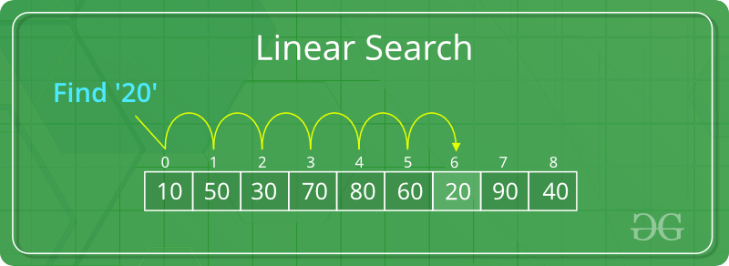
In the above array
Element to be searched=20
20 is compared with element present at index 0,1,2…..
At index 6 we get the element is found.

Slide 10
Algorithm
Step 1: Select the first element as the current element.
Step 2: Compare the current element with the target element. If matches, then go to step 5.
Step 3: If there is a next element, then set current element to next element and go to Step 2.
Step 4: Target element not found. Go to Step 6.
Step 5: Target element found and return location.
Step 6: Exit process.

Slide 11
program
#include<stdio.h>
int main()
{
int a[20],i,x,n;
printf("How many elements?");
scanf("%d",&n);
printf("Enter array elements:n");
for(i=0;i<n;++i)
scanf("%d",&a[i]);
printf(“\n Enter element to search:");
scanf("%d",&x);
for(i=0;i<n;++i)
if(a[i]==x)
break;
if(i<n)
printf("Element found at index %d",i);
else
printf("Element not found");
return 0;
}

Slide 12
Features of Linear Search Algorithm
It is used for unsorted and unordered small list of elements.
It has a time complexity of O(n), which means the time is linearly dependent on the number of elements, which is not bad, but not that good too.
It has a very simple implementation.

Slide 13
Linear search
Advantages
Dis advantage
It is easy to implement and understand.
Array or list can be in sorted or unsorted order.
If the search element is located at the beginning of the list ,then less comparisions are done
Slow if the list is large.
When search element is at the end of the list , the search takes more time to execute

Slide 14
Binary search
Binary search is a fast search algorithm with run-time complexity of Ο(log n).
This search algorithm works on the principle of divide and conquer. For this algorithm to work properly, the data collection should be in the sorted form.
Binary search looks for a particular element by comparing the middle most element of the collection.
If a match occurs, then the index of element is returned.
If the middle element is greater than the search element, then the element is searched in the sub-array to the left of the middle element.
Otherwise, the element is searched for in the sub-array to the right of the middle element.
This process continues on the sub-array as well until the size of the sub array reduces to zero.

Slide 15
Implementation of binary search
Compare search element with the middle element.
If search element matches with middle element, we return the mid index.
Else If search element is greater than the mid element, then search element can only lie in right half subarray after the mid element. So we recur for right half.
Else (search element is smaller) recur for the left half.

Slide 16

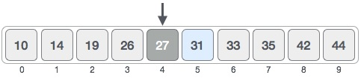
How Binary Search Works
For a binary search to work, it is mandatory for the target array to be sorted. The following is our sorted array and let us assume that we need to search the location of value 31 using binary search.
mid = low +( high-low)/2 low=0,high=9
Here it is, 0 + (9 - 0 ) / 2 = 4 (integer value of 4.5). So, 4 is the mid of the array.
low
high
mid

Slide 17

Now we compare the value stored at location 4, with the value being searched, i.e. 31.
We find that the value at location 4 is 27, which is not a match. As the value is greater than 27 and we have a sorted array, so we also know that the target value must be in the upper portion of the array.
We change our low to mid + 1 and find the new mid value again.
Low =mid+1
mid = low +( high-low)/2 low=5,high=9
i.e mid=5+(9-5)/2
=5+2
=7
Our new mid is 7 now. We compare the value stored at location 7 with our target value 31.
low
high

Slide 18
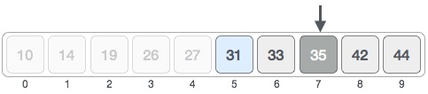
low
New positions
mid
high

Slide 19

The value stored at location 7 is not a match, rather it is more than what we are looking for. So, the value must be in the lower part so left side
High =mid-1 & Low is same value
Mid=5+(6-5)/2 =5.5
This time it is 5.
mid
high

Slide 20

We compare the value stored at location 5 with our target value. We find that it is a match.
Target

Slide 21
Algorithm for binary search
step1- Select the element in the middle of the array.
step2- Compare the mid element to the searched element, if it is equal to the searched element, terminate.
step3- If the searched element is larger than the selected element, repeat the search operation in the major part of the selected element.
step4- If the searched element is smaller than the selected element, repeat the search in the smaller part of the selected element.
step5- Repeat the steps until the smallest index in the search space is less than or equal to the largest index.

Slide 22
program
#include<stdio.h>
void main()
{
int a[20],i, n, key, low, high, mid;
printf("enter n value");
scanf("%d",&n);
printf("Enter the array elements in ascending order");
for(i=0;i<n;i++)
{
scanf("%d",&a[i]);
} printf("Enter the key element\n");
scanf("%d",&key);
low=0; high=n-1;
while(high>=low)
{
mid=low+(high-low)/2;
if(key==a[mid])
break;
else
{
if(key>a[mid])
low=mid+1;
else high=mid-1;
}
}
if(key==a[mid])
printf("The key element is found at location %d",mid+1);
else
printf("the key element is not found");
}

Slide 23
Binary search
Advantage
Dis advantage
Fast because search is performed only on the half of the list , other half is not considered
List must be in sorted order.
Complicated to implement.

Slide 24
SORTING TECHNIQUES
Sorting refers to arranging data in a particular format. Sorting algorithm specifies the way to arrange data in a particular order. Most common orders are in numerical or lexicographical order
The importance of sorting lies in the fact that data searching can be optimized to a very high level, if data is stored in a sorted manner. Sorting is also used to represent data in more readable formats. Following are some of the examples of sorting in real-life scenarios −

Slide 25
Telephone Directory − The telephone directory stores the telephone numbers of people sorted by their names, so that the names can be searched easily.
Dictionary − The dictionary stores words in an alphabetical order so that searching of any word becomes easy.
Some of the sorting techniques in use are-
Bubble sort
Insertion sort
Selection sort

Slide 26
BUBBLE SORT
Bubble sort is a simple sorting algorithm.
This sorting algorithm is comparison-based algorithm in which each pair of adjacent elements is compared and the elements are swapped if they are not in order.
This algorithm is not suitable for large data sets as its average and worst case complexity are of Ο(n²) where n is the number of items.

Slide 27
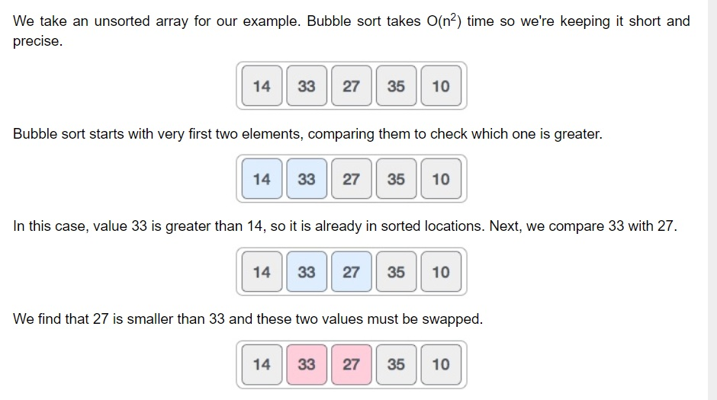

Slide 28
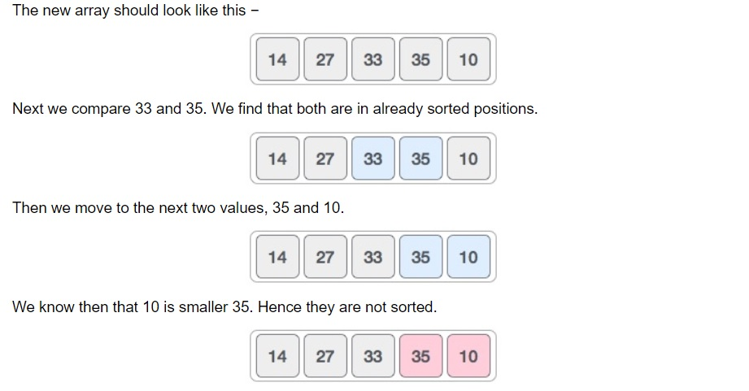

Slide 29
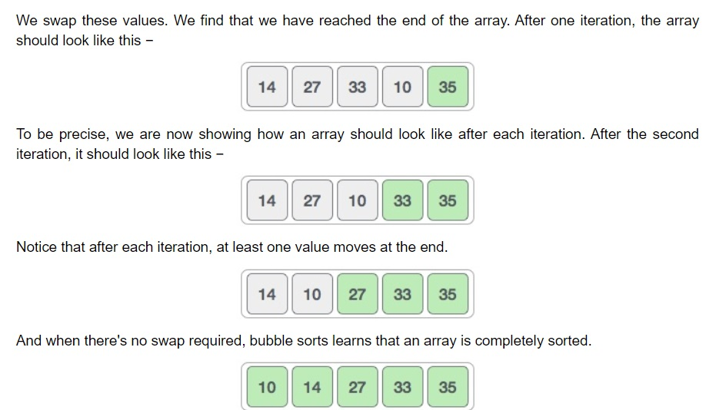

Slide 30
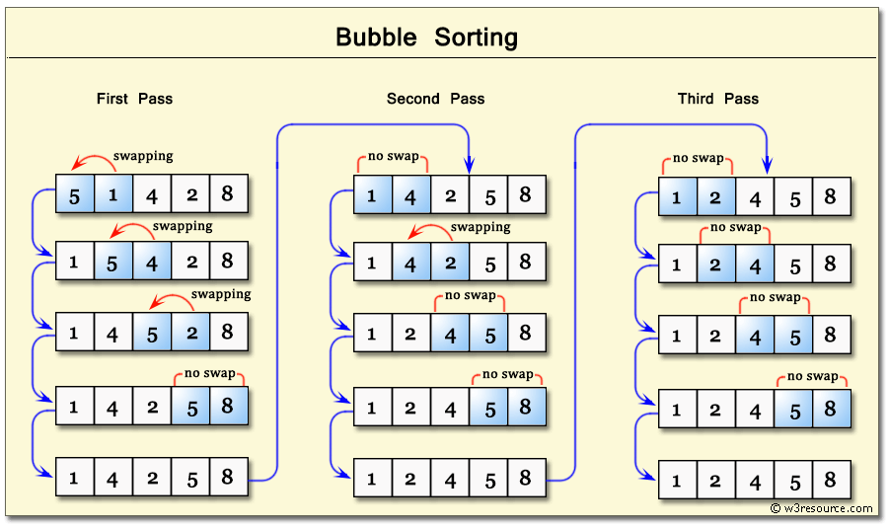
Example-2

Slide 31
#include<stdio.h>
int main()
{
int count, temp, i, j, number[30];
printf("How many numbers are u going to enter?: ");
scanf("%d",&count);
printf("Enter %d numbers: ",count);
for(i=0;i<count;i++)
scanf("%d",&number[i]);
for(i=count-2;i>=0;i--)
{

Slide 32
for(j=0;j<=i;j++)
{
if(number[j]>number[j+1])
{
temp=number[j];
number[j]=number[j+1];
number[j+1]=temp;
}
}
}
printf("Sorted elements: ");
for(i=0;i<count;i++)
printf(" %d",number[i]);
return 0;
}

Slide 33
INSERTION SORT
This is an in-place comparison-based sorting algorithm.
Here, a sub-list is maintained which is always sorted.
For example, the lower part of an array is maintained to be sorted.
An element which is to be 'insert'ed in this sorted sub-list, has to find its appropriate place and then it has to be inserted there.
Hence the name, insertion sort.

Slide 34
Following are the steps involved in insertion sort:
We start by making the second element of the given array, i.e. element at index 1, the key.
We compare the key element with the element(s) before it, in this case, element at index 0:
If the key element is less than the first element, we insert the key element before the first element.
If the key element is greater than the first element, then we insert it after the first element.
Then, we make the third element of the array as key and will compare it with elements to it's left and insert it at the right position.
And we go on repeating this, until the array is sorted.

Slide 35
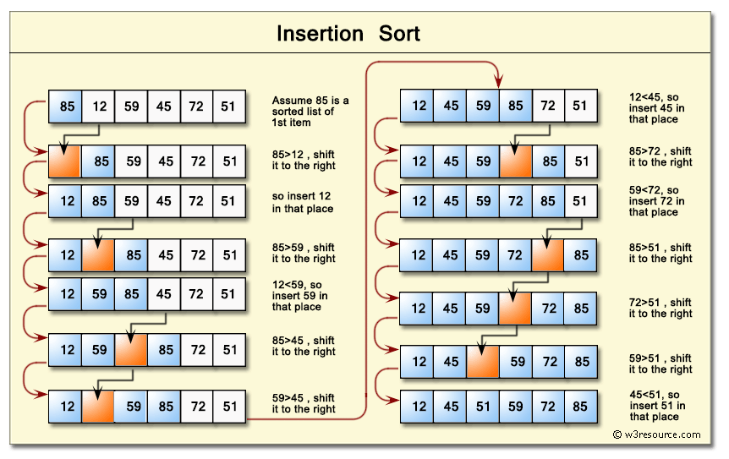

Slide 36
#include<stdio.h>
int main()
{
int i, j, count, temp, number[25];
printf("How many numbers u are going to enter?: ");
scanf("%d",&count);
printf("Enter %d elements: ", count);
// This loop would store the input numbers in array
for(i=0;i<count;i++)
scanf("%d",&number[i]);

Slide 37
// Implementation of insertion sort algorithm
for(i=1;i<count;i++)
{
temp=number[i];
j=i-1;
while((temp<number[j])&&(j>=0))
{
number[j+1]=number[j];
j=j-1;
}
number[j+1]=temp;
}
printf("Order of Sorted elements: ");
for(i=0;i<count;i++)
printf(" %d",number[i]);
return 0;
}

Slide 38
SELECTION SORT
The selection sort algorithm sorts an array by repeatedly finding the minimum element (considering ascending order) from unsorted part and putting it at the beginning. The algorithm maintains two subarrays in a given array.
1) The subarray which is already sorted.
2) Remaining subarray which is unsorted.
In every iteration of selection sort, the minimum element (considering ascending order) from the unsorted subarray is picked and moved to the sorted subarray.

Slide 39
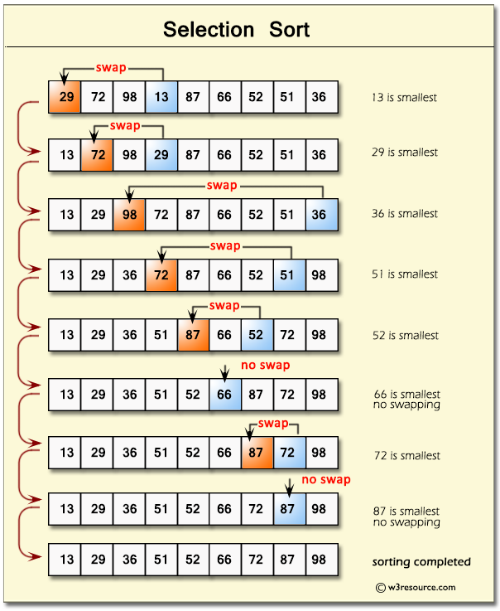

Slide 40
#include<stdio.h>
int main()
{
/* Here i & j for loop counters, temp for swapping,
* count for total number of elements, number[] to
* store the input numbers in array. You can increase
* or decrease the size of number array as per requirement
*/
int i, j, count, temp, number[25];
printf("How many numbers u are going to enter?: ");
scanf("%d",&count);
printf("Enter %d elements: ", count);
// Loop to get the elements stored in array
for(i=0;i<count;i++)
scanf("%d",&number[i]);

Slide 41
// Logic of selection sort algorithm
for(i=0;i<count;i++){
for(j=i+1;j<count;j++){
if(number[i]>number[j]){
temp=number[i];
number[i]=number[j];
number[j]=temp;
}
}
}
printf("Sorted elements: ");
for(i=0;i<count;i++)
printf(" %d",number[i]);
return 0;
}

Slide 42
Order of complexity of the algorithms
The efficiency of an algorithm is mainly defined by two factors i.e. space and time.
A good algorithm is one that is taking less time and less space, but this is not possible all the time.
There is a trade-off between time and space. If you want to reduce the time, then space might increase.
Similarly, if you want to reduce the space, then the time may increase.
So, you have to compromise with either space or time.
Let's learn more about space and time complexity of algorithms.

Slide 43
SPACE COMPLEXITY
Space Complexity of an algorithm denotes the total space used or needed by the algorithm for its working, for various input sizes.
TIME COMPLEXITY
Time Complexity of an algorithm is the representation of the amount of time required by the algorithm to execute to completion.
We can have three cases to analyze an algorithm:
Best Case − Minimum time required for program execution.
Average Case − Average time required for program execution.
Worst Case − Maximum time required for program execution.

Slide 44
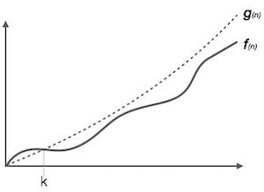
Asymptotic Notations
Following are the commonly used asymptotic notations to calculate the running time complexity of an algorithm.
Ο Notation – worst case
Ω Notation –best case
θ Notation – average case
Big Oh Notation, Ο
The notation Ο(n) is the formal way to express the upper bound of an algorithm's running time. It measures the worst case time complexity or the longest amount of time an algorithm can possibly take to complete
For example, for a function f(n)
Ο(f(n)) = { g(n) : there exists c > 0 and n0 such that f(n) ≤ c.g(n) for all n > n0. }

Slide 45
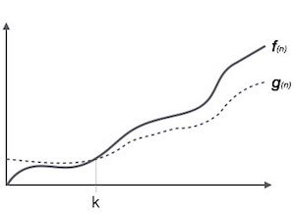
Omega Notation, Ω
The notation Ω(n) is the formal way to express the lower bound of an algorithm's running time. It measures the best case time complexity or the best amount of time an algorithm can possibly take to complete.
For example, for a function f(n)
Ω(f(n)) ≥ { g(n) : there exists c > 0 and n0 such that g(n) ≤ c.f(n) for all n > n0. }

Slide 46
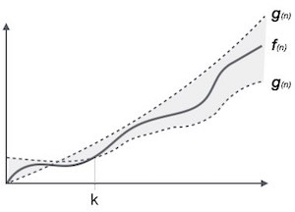
Theta Notation, θ
The notation θ(n) is the formal way to express both the lower bound and the upper bound of an algorithm's running time. It is represented as follows
θ(f(n)) = { g(n) if and only if g(n) = Ο(f(n)) and g(n) = Ω(f(n)) for all n > n0. }

Slide 47
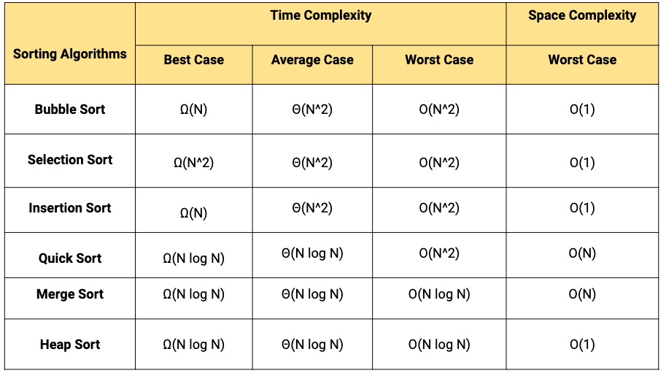

Slide 48
